Slide 1



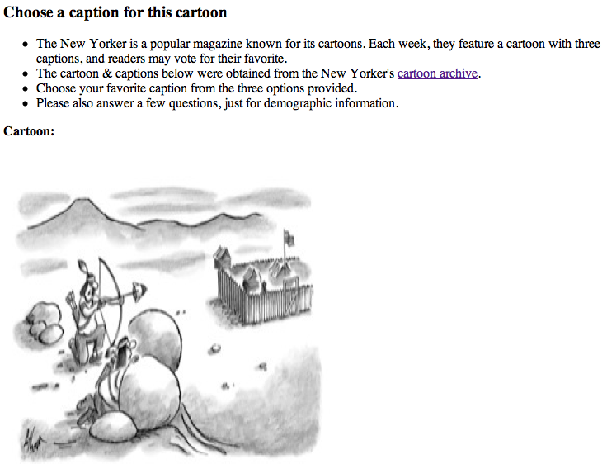
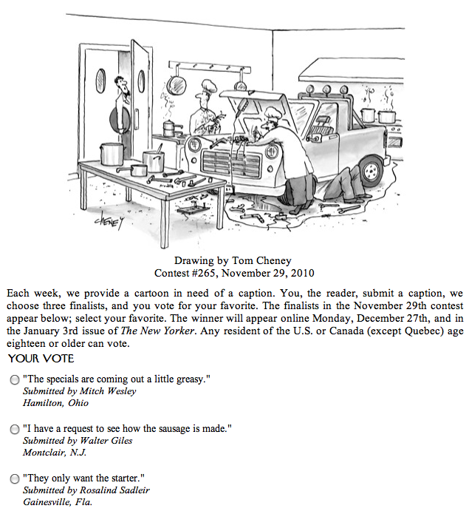
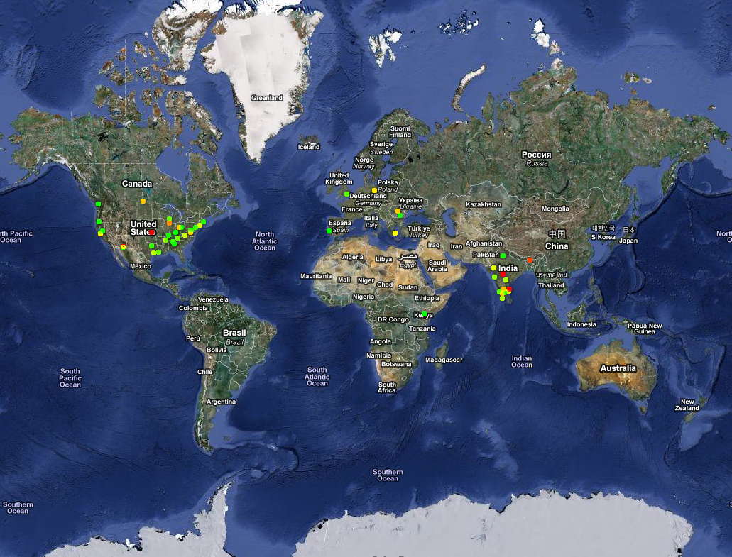
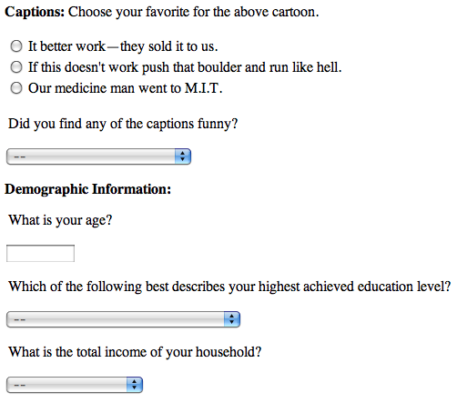
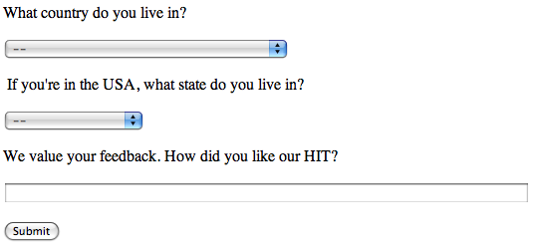
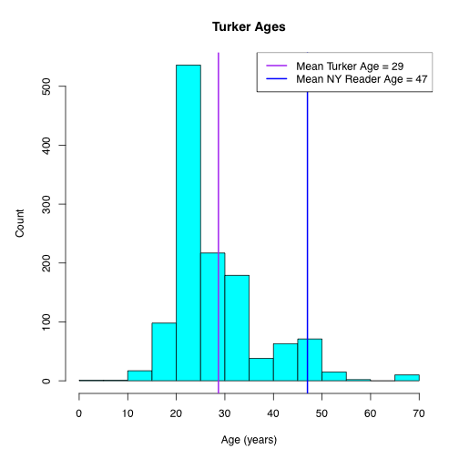
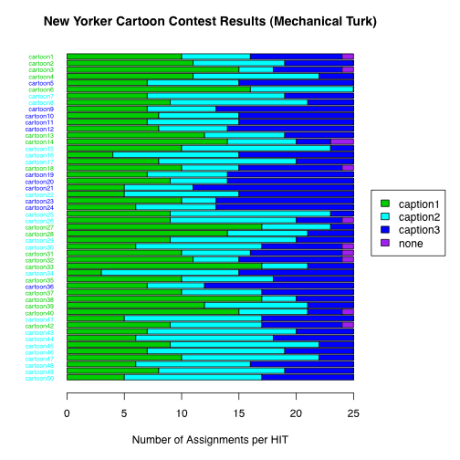
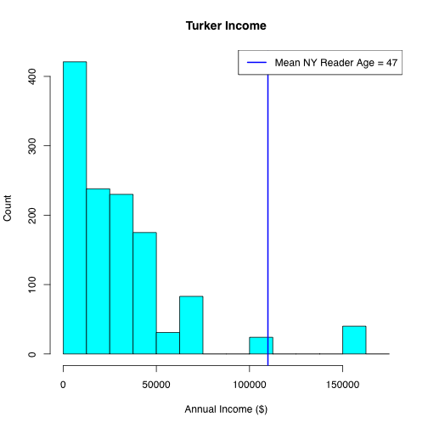
Are Turkers like New Yorkers? Kristal Curtis, Tim Kraska, Armando Fox, David Patterson
Problem Description
Crowdsourcing is an exciting new opportunity
Mechanical Turk is a flexible way to participate in crowd sourcing
Our goal: explore what kinds of tasks we can expect Turkers to do
Can we expect Turkers to weigh in on matters involving cultural knowledge/common sense?
Our experiment: Do Turkers have the same sense of humor as New Yorker readers?
Compare results from New Yorker cartoon caption contest to Turkers’ favorite captions
Would expect them to diverge
HIT Design/Evolution
Went through several iterations to design the Human Intelligence Task (HIT)
Sources of feedback:
Input field in the original HIT
Turker Nation (www.turkernation.com), a message board used by Turkers to communicate about good/bad requestors (the people actually issuing the HITs), interesting HITs, etc.
Actual HIT:
Results
Batch timing
Posted at 10:19am (PST)
Completed at 11:03am (PST)
Batch rewards
$0.05 per HIT (consulted with Turkers on Turker Nation to set this reward)
Average hourly rate: $3.75
Turker demographics vs. New Yorker reader demographics [data for 2009, from Wikipedia]
Techniques Used:
Scraped data from New Yorker website (used hpricot & XPath)
Used JavaScript to randomly shuffle the captions (otherwise first one is always the actual winner)
Used JavaScript to capture the Turkers’ IP addresses
Heatmap of Turker Locations (based on IP)
Related Work
This work is related to studies of the demographics of Mechanical Turk
Lots of interesting results in this sphere from Panos Ipeirotis (NYU)
Most Turkers are from either the US (50%) or India (40%), probably because Amazon supports paying in local currencies in these countries
They’re usually younger and less affluent than the general population
More women participate in the US, while more men participate in India
Turkers’ voting results
HIT Batch Details:
One HIT template
50 distinct HITs, each with a different New Yorker cartoon
25 assignments per HIT
1250 responses total
Workers can do multiple HITs, but only one assignment per HIT

